Slide 1


MY SQL PROJECT
Introduction:
In today's digital world, managing data efficiently is essential for all organizations. MySQL, a popular open-source relational database system, uses SQL to store, retrieve, and manage information reliably. This project builds a database system to handle key operations smoothly.
RISHU HRITHIK

Slide 2

MY SQL PROJECT
Objectives:
To design and implement a fully normalized database schema (up to 3NF) with related tables, ensuring data integrity through primary/foreign keys and constraints.
To develop comprehensive CRUD operations via SQL DML statements, enabling efficient Create (INSERT), Read (SELECT with JOINs), Update (UPDATE), and Delete (DELETE) functionalities across complex queries.
To produce actionable analytical reports using aggregate functions (COUNT, SUM, AVG), GROUP BY, subqueries, and views for data-driven insights.
RISHU HRITHIK

Slide 3
MY SQL PROJECT
Scope :
This project covers core database design, data operations, and basic reporting using sample data. It excludes advanced features like user authentication, real-time updates, or external API integrations.
Methodology :
The project follows standard database development steps—creating ER diagrams for planning, using DDL statements for table structure, DML for data insertion, and DQL queries for retrieval and analysis. Tools include MySQL Workbench for design and MySQL command line for execution.
RISHU HRITHIK

Slide 4

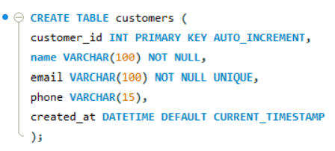
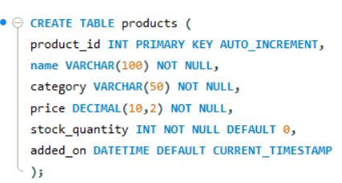
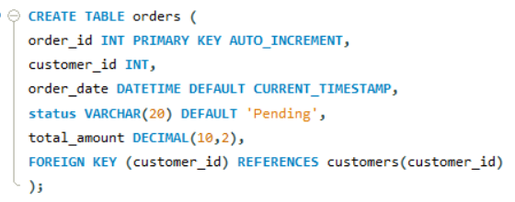
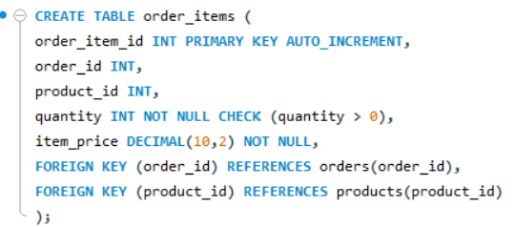
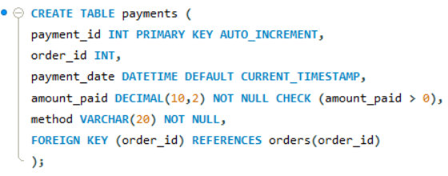
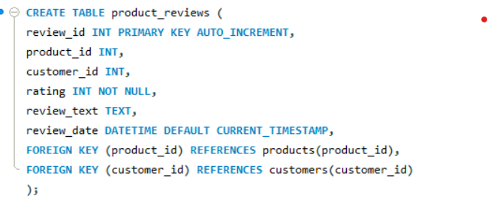
MY SQL PROJECT
TABLES CREATION :
RISHU HRITHIK

Slide 5
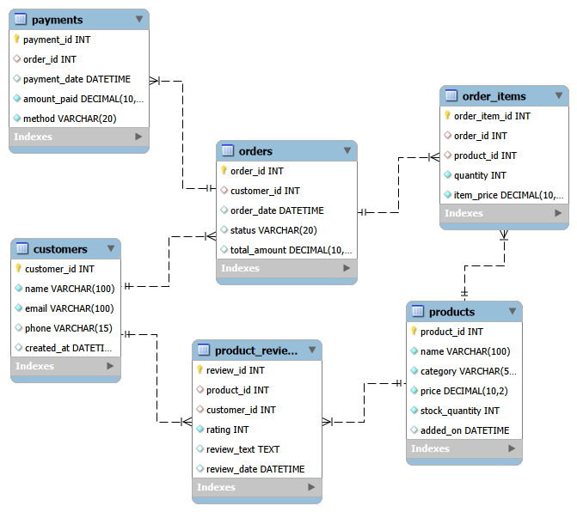
MY SQL PROJECT
ER Diagram
RISHU HRITHIK

Slide 6
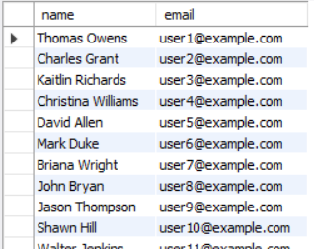
MY SQL PROJECT
1. Retrieve customer names and emails for email marketing
QUESTION
LEVEL:1
QUERY
OUTPUT
select name, email from customers;
RISHU HRITHIK

Slide 7
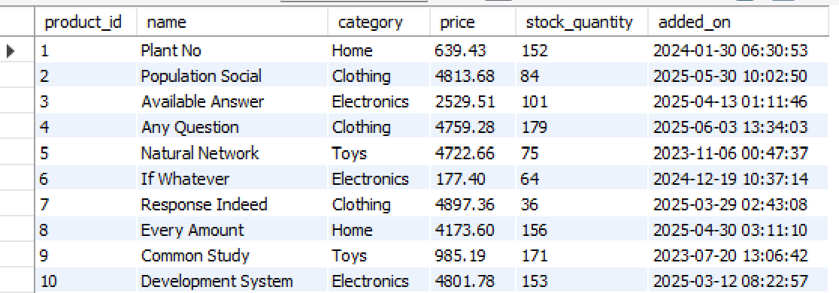
MY SQL PROJECT
2. View complete product catalog with all available details
QUESTION
LEVEL:1
QUERY
OUTPUT
select * from products;
RISHU HRITHIK

Slide 8
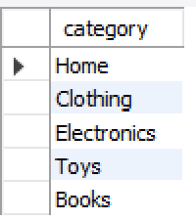
MY SQL PROJECT
3. List all unique product categories
QUESTION
LEVEL:1
QUERY
OUTPUT
select distinct(category) from products;
RISHU HRITHIK

Slide 9
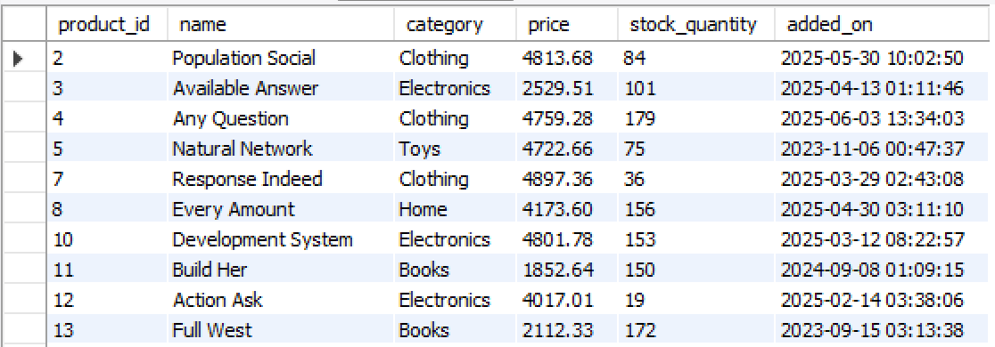
MY SQL PROJECT
4. Show all products priced above ₹1,000
QUESTION
LEVEL:1
QUERY
OUTPUT
select * from products where price > 1000;
RISHU HRITHIK

Slide 10
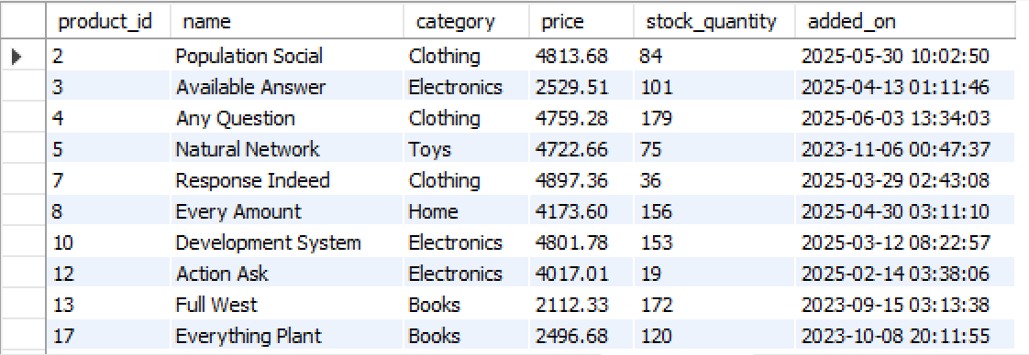
MY SQL PROJECT
5. Display products within a mid-range price bracket (₹2,000 to ₹5,000)
QUESTION
LEVEL:1
QUERY
OUTPUT
select * from products where price>2000 and price<5000;
-- we can also use price BETWEEN 2000 AND 5000.
RISHU HRITHIK

Slide 11
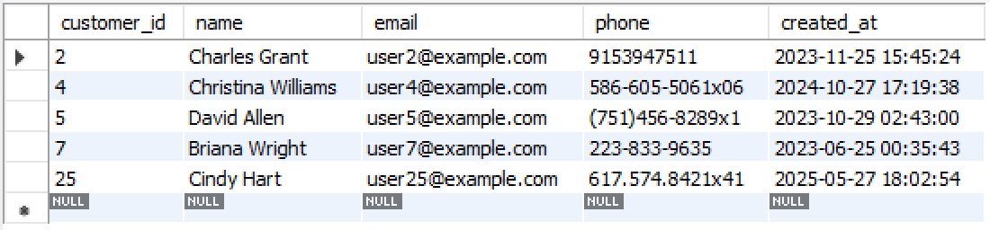
MY SQL PROJECT
6. Fetch data for specific customer IDs (e.g., from loyalty program list)
QUESTION
LEVEL:1
QUERY
OUTPUT
select * from customers where customer_id in (2,4,5,7,25);
RISHU HRITHIK

Slide 12
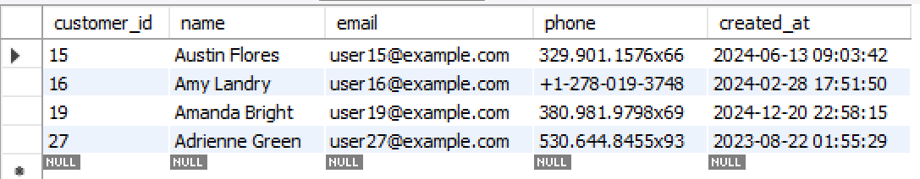
MY SQL PROJECT
7. Identify customers whose names start with the letter ‘A’
QUESTION
LEVEL:1
QUERY
OUTPUT
select * from customers
where substring(name,1,1) in ("a", "A");
RISHU HRITHIK

Slide 13
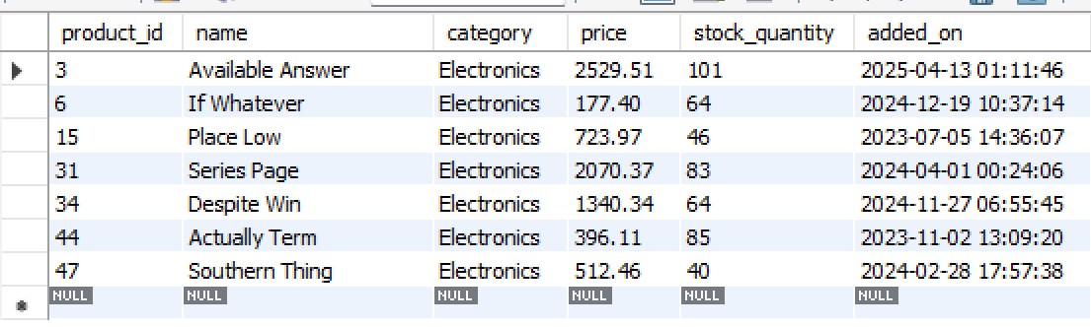
MY SQL PROJECT
8. List electronics products priced under ₹3,000
QUESTION
LEVEL:1
QUERY
OUTPUT
select * from products where category = "Electronics" and price < 3000;
RISHU HRITHIK

Slide 14
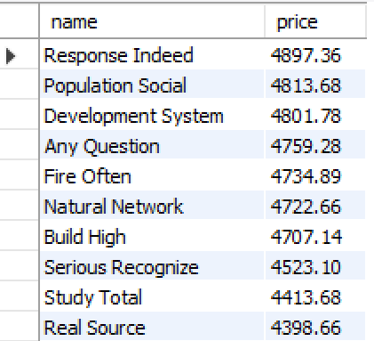
MY SQL PROJECT
9. Display product names and prices in descending order of price
QUESTION
LEVEL:1
QUERY
OUTPUT
select name, price from products order by price desc;
RISHU HRITHIK

Slide 15
MY SQL PROJECT
10. Display product names and prices, sorted by price and then by name
QUESTION
LEVEL:1
QUERY
OUTPUT
select name, price from products order by price desc, name;
RISHU HRITHIK

Slide 16
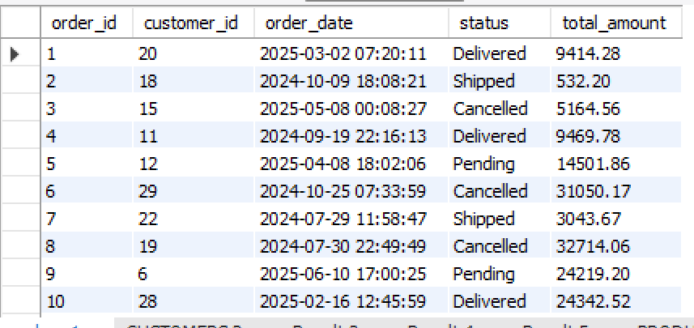
MY SQL PROJECT
1. Retrieve orders where customer information is missing (possibly due to data migration or deletion)
QUESTION
LEVEL:2
QUERY
OUTPUT
select * from orders where customer_id is not null;
-- all orders customers detail is linked
RISHU HRITHIK

Slide 17
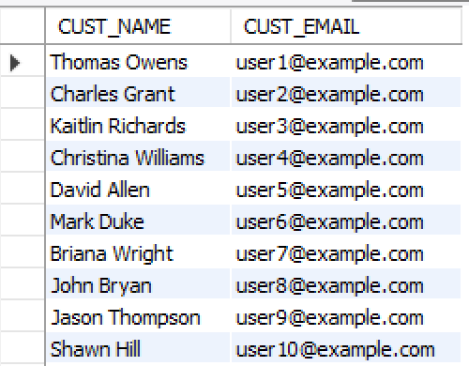
MY SQL PROJECT
2. Display customer names and emails using column aliases for frontend readability
QUESTION
LEVEL:2
QUERY
OUTPUT
SELECT NAME AS CUST_NAME, EMAIL AS CUST_EMAIL FROM CUSTOMERS;
RISHU HRITHIK

Slide 18
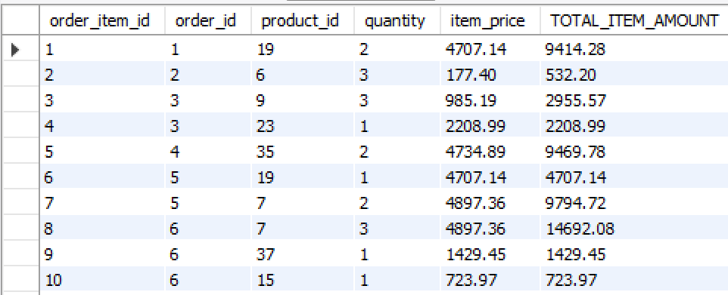
MY SQL PROJECT
3. Calculate total value per item ordered by multiplying quantity and item price
QUESTION
LEVEL:2
QUERY
OUTPUT
SELECT * , QUANTITY*ITEM_PRICE AS TOTAL_ITEM_AMOUNT FROM order_items;
RISHU HRITHIK

Slide 19
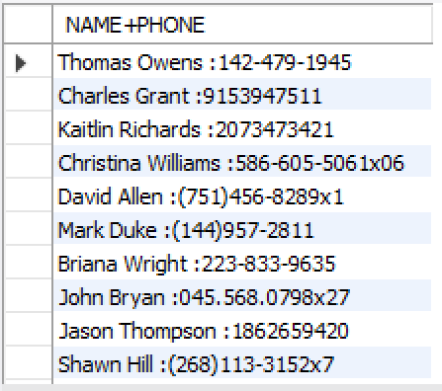
MY SQL PROJECT
4. Combine customer name and phone number in a single column
QUESTION
LEVEL:2
QUERY
OUTPUT
SELECT concat(NAME,’ ',':',PHONE) AS 'NAME+PHONE' FROM CUSTOMERS;
RISHU HRITHIK

Slide 20
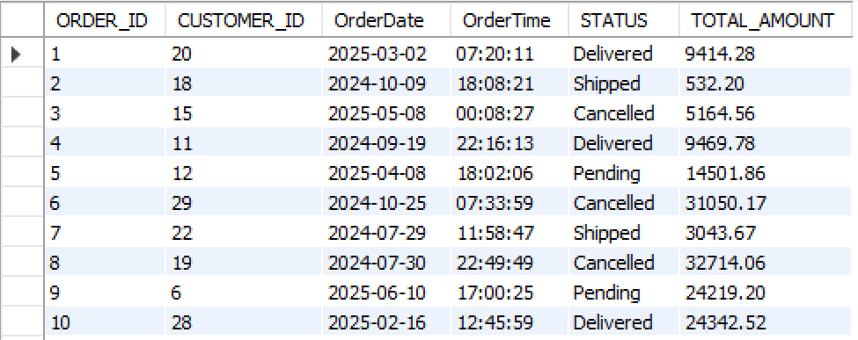
MY SQL PROJECT
5. Extract only the date part from order timestamps for date-wise reporting
QUESTION
LEVEL:2
QUERY
OUTPUT
SELECT ORDER_ID, CUSTOMER_ID, DATE(ORDER_DATE) AS OrderDate, TIME(ORDER_DATE) AS OrderTime, STATUS, TOTAL_AMOUNT FROM ORDERS;
RISHU HRITHIK

Slide 21
MY SQL PROJECT
6. List products that do not have any stock left
QUESTION
LEVEL:2
QUERY
OUTPUT
SELECT * FROM PRODUCTS WHERE STOCK_QUANTITY = 0 OR STOCK_QUANTITY IS NULL;
All products are in stock
RISHU HRITHIK

Slide 22

MY SQL PROJECT
1. Count the total number of orders placed
QUESTION
LEVEL:3
QUERY
OUTPUT
SELECT COUNT(ORDER_ID) AS TOTAL_ORDER_PLACED FROM ORDERS;
RISHU HRITHIK

Slide 23

MY SQL PROJECT
2. Calculate the total revenue collected from all orders
QUESTION
LEVEL:3
QUERY
OUTPUT
SELECT SUM(TOTAL_AMOUNT) AS TOTAL_REVENUE FROM ORDERS;
-- ALL THE ORDERS(CANCELLED ALSO INCLUDED)
RISHU HRITHIK

Slide 24

MY SQL PROJECT
3. Calculate the average order value
QUESTION
LEVEL:3
QUERY
OUTPUT
SELECT ROUND(AVG(TOTAL_AMOUNT),2) AS AVG_ORDER_VALUE FROM ORDERS;
RISHU HRITHIK

Slide 25

MY SQL PROJECT
4. Count the number of customers who have placed at least one order
QUESTION
LEVEL:3
QUERY
OUTPUT
SELECT COUNT(CUSTOMER_ID) AS CUST_WITH_MIN_1_ORDER FROM CUSTOMERS WHERE CUSTOMER_ID IN (SELECT CUSTOMER_ID FROM ORDERS);
RISHU HRITHIK

Slide 26
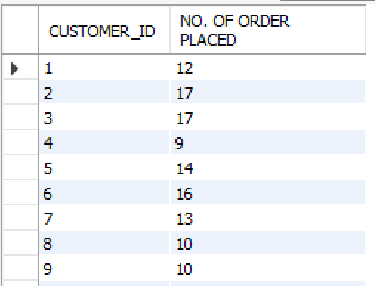
MY SQL PROJECT
5. Find the number of orders placed by each customer
QUESTION
LEVEL:3
QUERY
OUTPUT
SELECT CUSTOMER_ID, COUNT(ORDER_ID) AS 'NO. OF ORDER PLACED' FROM ORDERS GROUP BY CUSTOMER_ID;
RISHU HRITHIK

Slide 27
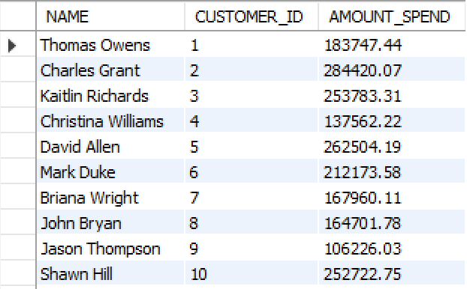
MY SQL PROJECT
6. Find total sales amount made by each customer
QUESTION
LEVEL:3
QUERY
OUTPUT
SELECT CUSTOMERS.NAME, ORDERS.CUSTOMER_ID AS CUSTOMER_ID, SUM(ORDERS.TOTAL_AMOUNT) AS AMOUNT_SPEND FROM ORDERS INNER JOIN CUSTOMERS ON CUSTOMERS.CUSTOMER_ID = ORDERS.CUSTOMER_ID GROUP BY CUSTOMER_ID;
RISHU HRITHIK

Slide 28
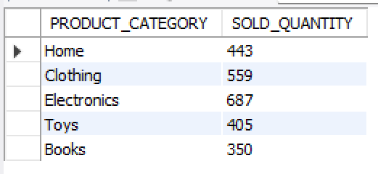
MY SQL PROJECT
7. List the number of products sold per category
QUESTION
LEVEL:3
QUERY
OUTPUT
SELECT products.CATEGORY AS PRODUCT_CATEGORY, SUM(order_items.QUANTITY) AS SOLD_QUANTITYFROM products INNER JOIN order_items ON products.product_id = order_items.product_id GROUP BY CATEGORY;
RISHU HRITHIK

Slide 29
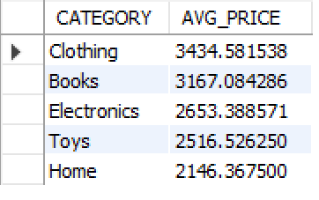
MY SQL PROJECT
8. Find the average item price per category
QUESTION
LEVEL:3
QUERY
OUTPUT
SELECT CATEGORY, avg(PRICE) AS AVG_PRICE FROM products group by category order by AVG_PRICE desc;
RISHU HRITHIK

Slide 30
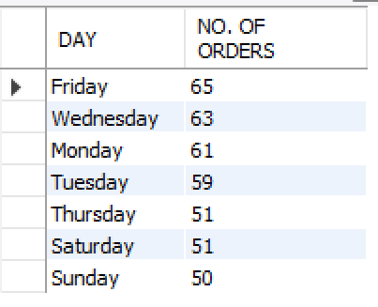
MY SQL PROJECT
9. Show number of orders placed per day
QUESTION
LEVEL:3
QUERY
OUTPUT
SELECT dayname(order_date) AS DAY , count(order_id) AS "NO. OF ORDERS" FROM ORDERS group by DAY order by count(order_id) DESC;
RISHU HRITHIK

Slide 31
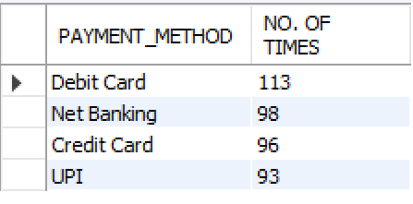
MY SQL PROJECT
10. List total payments received per payment method
QUESTION
LEVEL:3
QUERY
OUTPUT
SELECT METHOD AS PAYMENT_METHOD, COUNT(PAYMENT_ID) AS "NO. OF TIMES" FROM PAYMENTS GROUP BY METHOD ORDER BY COUNT(PAYMENT_ID) DESC;
RISHU HRITHIK

Slide 32
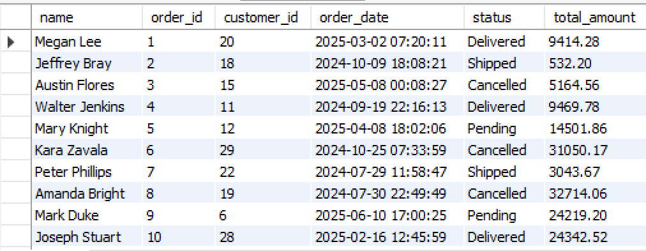
MY SQL PROJECT
1. Retrieve order details along with the customer name (INNER JOIN)
QUESTION
LEVEL:4
QUERY
OUTPUT
select customers.name , orders.* from customers inner join orders on customers.customer_id = orders.customer_id order by order_id;
RISHU HRITHIK

Slide 33
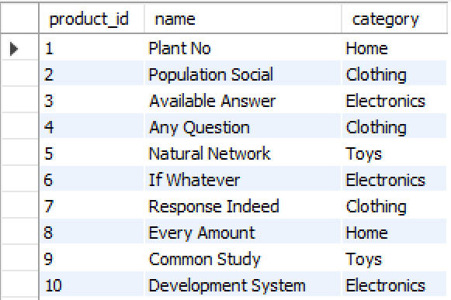
MY SQL PROJECT
2. Get list of products that have been sold (INNER JOIN with order_items)
QUESTION
LEVEL:4
QUERY
OUTPUT
select distinct products.product_id,products.name, products.categoryfrom products inner join order_items on products.product_id = order_items.product_id;
RISHU HRITHIK

Slide 34
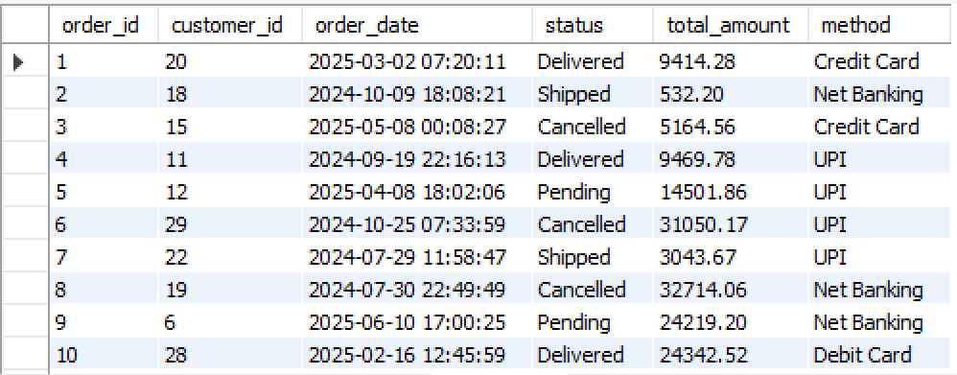
MY SQL PROJECT
3. List all orders with their payment method (INNER JOIN)
QUESTION
LEVEL:4
QUERY
OUTPUT
select orders.* , payments.method from orders inner join payments on orders.order_id = payments.order_id;
RISHU HRITHIK

Slide 35
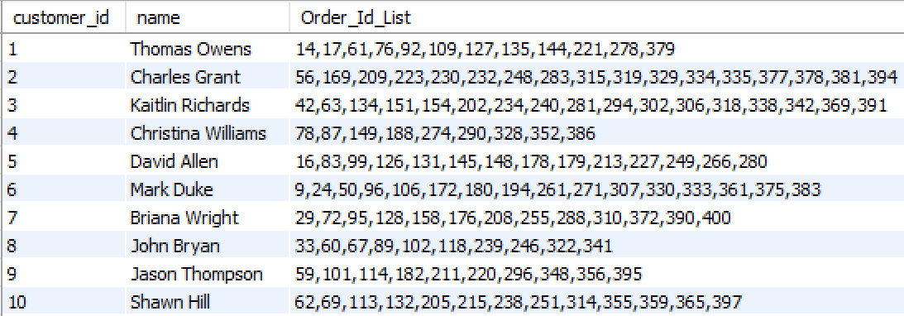
MY SQL PROJECT
4. Get list of customers and their orders (LEFT JOIN)
QUESTION
LEVEL:4
QUERY
OUTPUT
select customers.customer_id, customers.name, group_concat(orders.order_id order by orders.order_id asc separator ',') as Order_Id_Listfrom customers left join orders on customers.customer_id = orders.customer_id group by customers.customer_id, customers.name;
RISHU HRITHIK

Slide 36
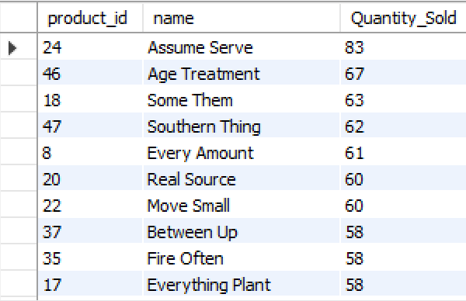
MY SQL PROJECT
5. List all products along with order item quantity (LEFT JOIN)
QUESTION
LEVEL:4
QUERY
OUTPUT
select p.product_id, p.name, sum(o.quantity) as Quantity_Sold from order_items as o left join products as p on o.product_id = p.product_id group by p.product_id, p.name order by Quantity_Sold desc;
RISHU HRITHIK

Slide 37
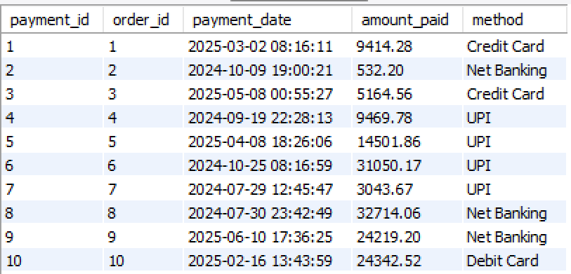
MY SQL PROJECT
6. List all payments including those with no matching orders (RIGHT JOIN)
QUESTION
LEVEL:4
QUERY
OUTPUT
select payments.* from orders right join payments on orders.order_id = payments.order_id;
RISHU HRITHIK

Slide 38
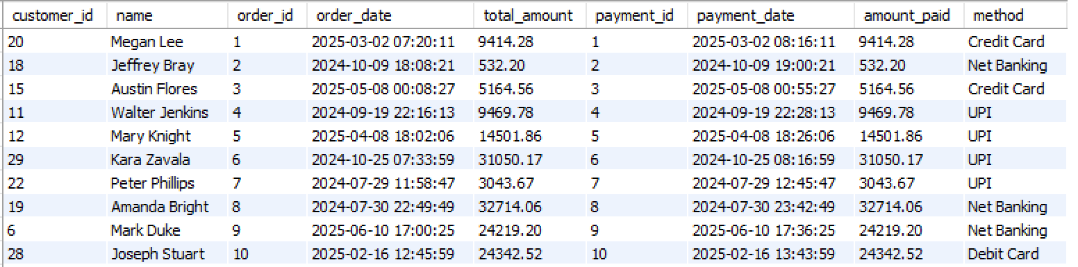
MY SQL PROJECT
7. Combine data from three tables: customer, order, and payment
QUESTION
LEVEL:4
QUERY
OUTPUT
select c.customer_id, c.name, o.order_id, o.order_date, o.total_amount, p.payment_id, p.payment_date, p.amount_paid, p.methodfrom customers as c inner join orders as o on c.customer_id = o.customer_id inner join payments as p on o.order_id = p.order_id order by o.order_id asc;
RISHU HRITHIK

Slide 39
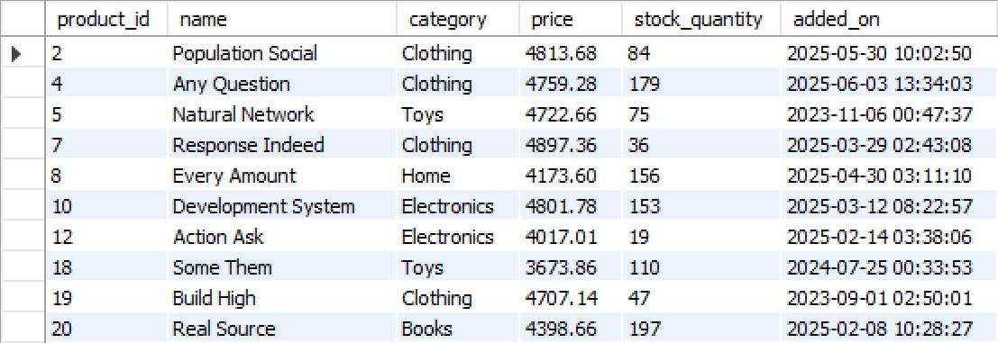
MY SQL PROJECT
1. List all products priced above the average product price
QUESTION
LEVEL:5
QUERY
OUTPUT
select * from products where price > (select avg(price) from products);
RISHU HRITHIK

Slide 40
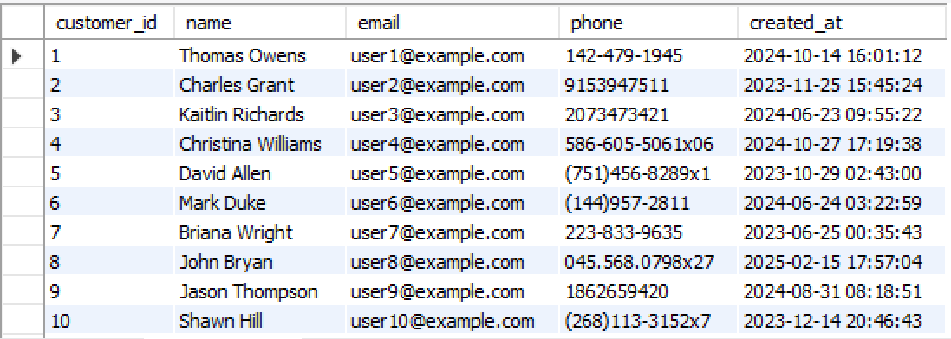
MY SQL PROJECT
2. Find customers who have placed at least one order
QUESTION
LEVEL:5
QUERY
OUTPUT
select * from customers where customer_id in (select customer_id from orders group by customer_id having count(order_id) >=1);
RISHU HRITHIK

Slide 41
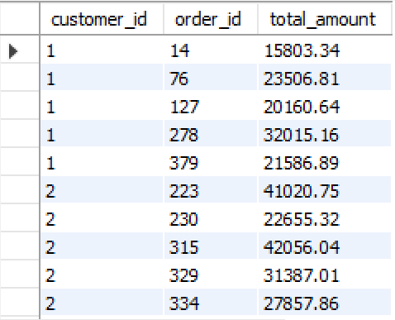
MY SQL PROJECT
3. Show orders whose total amount is above the average for that customer
QUESTION
LEVEL:5
QUERY
OUTPUT
with t as (select customer_id , avg(total_amount) as avg_amount_ from orders group by customer_id)
select o.customer_id, o.order_id , o.total_amount from orders as o inner join t on o.customer_id = t.customer_id where o.total_amount > t.avg_amount_;
RISHU HRITHIK

Slide 42

MY SQL PROJECT
4. Display customers who haven’t placed any orders
QUESTION
LEVEL:5
QUERY
OUTPUT
SELECT * FROM CUSTOMERS WHERE CUSTOMER_ID NOT IN (SELECT CUSTOMER_ID FROM ORDERS );
ALL CUSTOMERS HAVE PLACED ORDER
RISHU HRITHIK

Slide 43
MY SQL PROJECT
5. Show products that were never ordered
QUESTION
LEVEL:5
ALL PRODUCTS HAS BEEN ORDERED
QUERY
OUTPUT
select * from products where product_id not in (select product_id from order_items);
RISHU HRITHIK

Slide 44
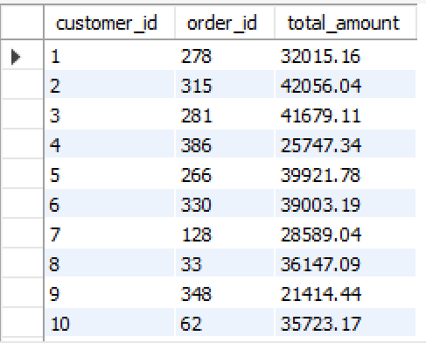
MY SQL PROJECT
6. Show highest value order per customer
QUESTION
LEVEL:5
QUERY
OUTPUT
select customer_id ,order_id, total_amount from orders as o1 where total_amount = (select max(total_amount) from orders as o2 where o1.customer_id = o2.customer_id) order by customer_id;
RISHU HRITHIK

Slide 45
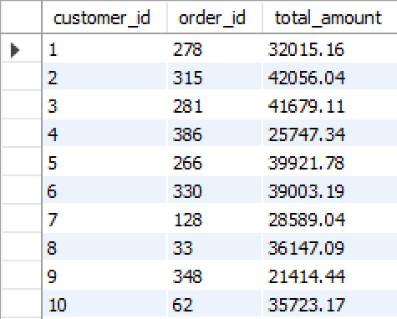
MY SQL PROJECT
7. Highest Order Per Customer (Including Names)
QUESTION
LEVEL:5
QUERY
OUTPUT
with t as ( select customer_id, max(total_amount) as Highest_Order from orders as o2 group by customer_id )
select c.customer_id, c.name, t.Highest_Order from customers as c join t on t.customer_id = c.customer_id;
RISHU HRITHIK

Slide 46
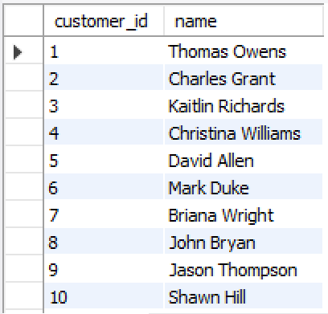
MY SQL PROJECT
1. List all customers who have either placed an order or written a product review
QUESTION
LEVEL:6
QUERY
OUTPUT
select customer_id, name from customers where customer_id in (select customer_id from customers union select customer_id from product_reviews);
RISHU HRITHIK

Slide 47
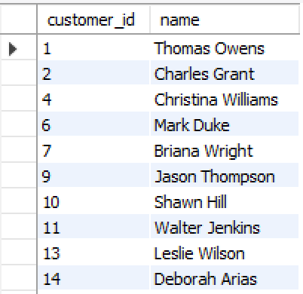
MY SQL PROJECT
2. List all customers who have placed an order as well as reviewed a product [intersect not supported]
QUESTION
LEVEL:6
QUERY
OUTPUT
select customer_id, name from customers where customer_id in (select customer_id from orders) and customer_id in (select customer_id from product_reviews);
RISHU HRITHIK

